Slide 1
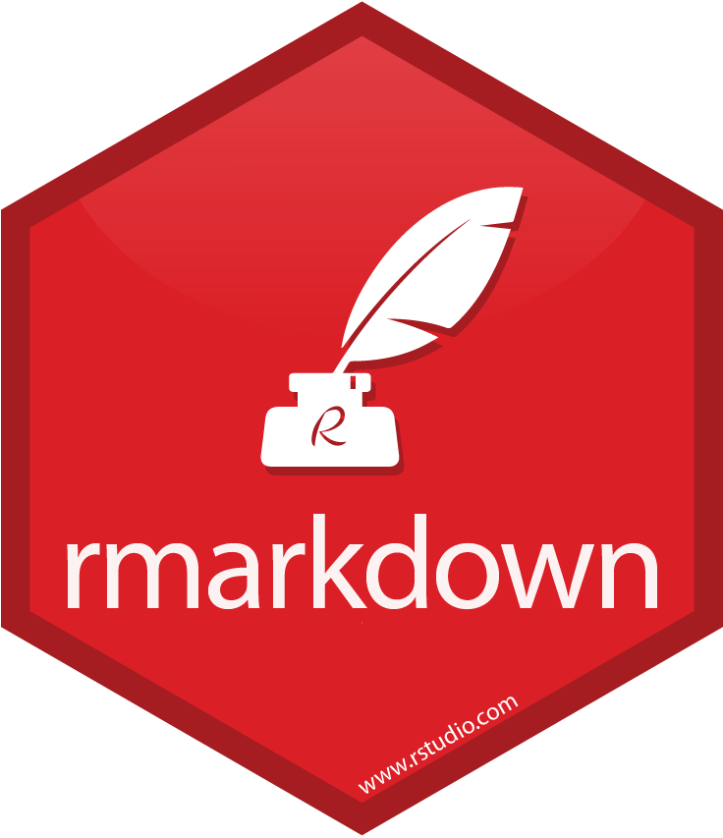
Making a report or presentation using Rmarkdown
Elham Haem, Ph.D
Assistant Professor of Biostatistics,
Shiraz university of medical science

Slide 2
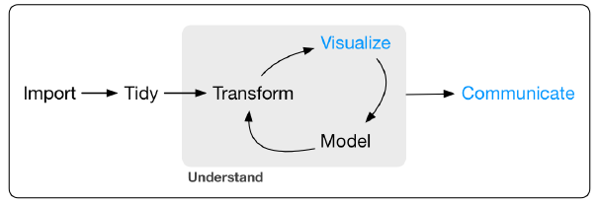
Why we need to use Rmarkdown?

Slide 3

R Markdown files are designed to be used in three ways:
• For communicating to decision makers, who want to focus on the conclusions, not the code behind the analysis.
• For collaborating with other data scientists (including future you!), who are interested in both your conclusions, and how you reached them (i.e., the code).
• As an environment in which to do data science, as a modern day lab notebook where you can capture not only what you did, but also what you were thinking.

Slide 4
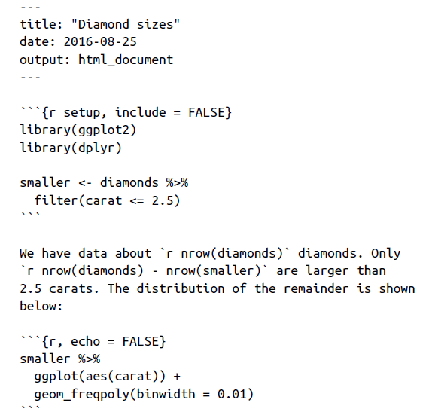
R Markdown Basics
An (optional) YAML header surrounded by ---s.
Chunks of R code surrounded by ```
Text mixed with simple text formatting like # heading and _italics_.

Slide 5
Caching

Slide 6
As your caching strategies get progressively more complicated, it’s
a good idea to regularly clear out all your caches with:
Knitr::clean_cache()

Slide 7
با تشکر از توجه شما

